Slide 1
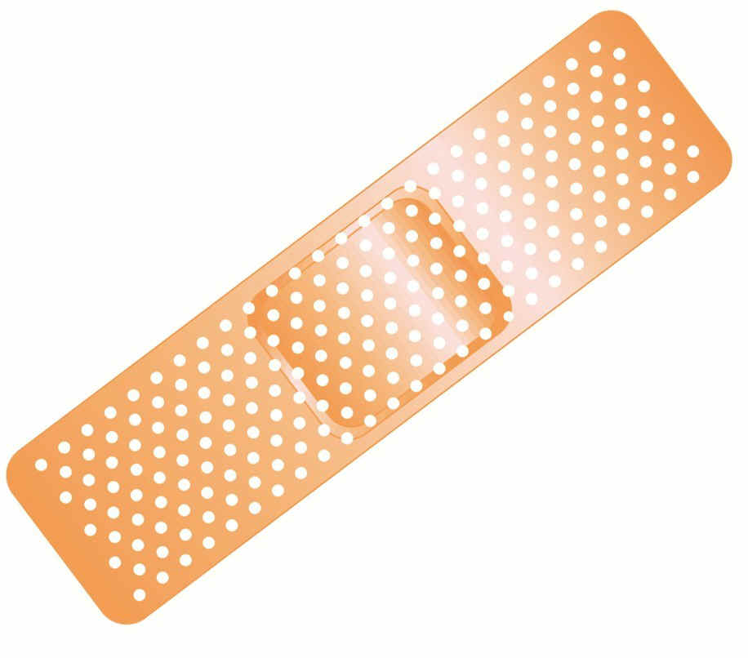
REGENERATION
HEALING
(repair)
Notes:
T&P means Title and Personality

Slide 2
LEARNING OBJECTIVES
Review the normal physiology and concepts of cell proliferation, cell growth, cell “cycle”, and cell differentiation
Understand the basic factors of tissue regeneration
Understand the relationships between cells and their ExtraCellular Matrix (ECM)
Understand the roles of the major players of healing---angiogenesis, growth factors (GFs), and fibrosis
Differentiate 1st & 2nd intention healing

Slide 3
DEFINITIONS:
REGENERATION: Growth of cells to replace lost tissues (no injury)
HEALING: A reparative tissue response to a wound, inflammation or necrosis, often leads to fibrosis (injury)
GRANULATION TISSUE
“ORGANIZING” INFLAMATION
NEOVASCULARIZATION
Notes:
Regeneration is a normal process, “healing” follows damage

Slide 4
REGENERATION
Replacement of lost structures
Is dependent on the type of normal turnover the original tissue has
Can be differentiated from “compensatory” growth
Notes:
An example of compensatory growth is when one kidney becomes larger after a nephrectomy, or the left portion on the right lobe of the liver “enlarges” after a left lobectomy.

Slide 5
HEALING (repair)
Needs a wound, inflammatory process, or necrosis
Many disease appearances anatomically are the result of “healing” such as atherosclerosis
Often ends with a scar
Fibrosis, as one of the 3 possible outcomes of inflammation, follows “healing”
Requires a connective tissue “scaffold”
Fibrosis occurs in proportion to the damage of the ECM, ExtraCellular Matrix
Notes:
Healing (repair), like inflammation, can be thought of as a predictable sequence of events, just like in the Cecil B. DeMille “Inflammation” epic!
I LIED.

Slide 6
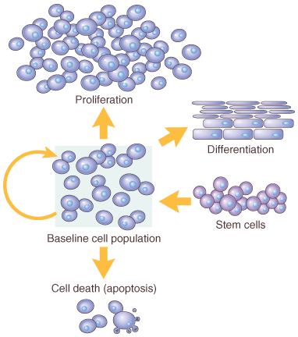
Notes:
Cells derived from stem cells can do only three things: 1) multiply 2) differentiate, or 3) die (apoptosis). I can’t think of anything else they can do.

Slide 7
Cell Population Fates
PROLIFERATION
  Hormonal, especially steroid hormones
  eg., EPO, CSF, GFs
DIFFERENTIATION*, vs. “multiply”
  “UNI”-DIRECTIONAL, GAIN and LOSS
APOPTOSIS
*One of the most KEY concepts in neoplasia
Notes:
There isn’t a single day in the life of a pathologist when he does not think of the concept of “differentiation” a lot, particularly in reference of neoplasms! Although most neoplasms do not look as “differentiated” as their mature tissues of origin, there is NO such thing as reverse differentiation. MAYBE!

Slide 8
ECTODERM, ep.
MESODERM, str.
ENTODERM, ep.
Notes:
Cells from these three areas behave similarly and look similarly, basically, epithelium vs. connective tissue. If you wanted to narrow this list down to only 2 histologic concepts, then epithelial (ectoderm and entoderm) and stromal (connective tissue or mesodermal)

Slide 9
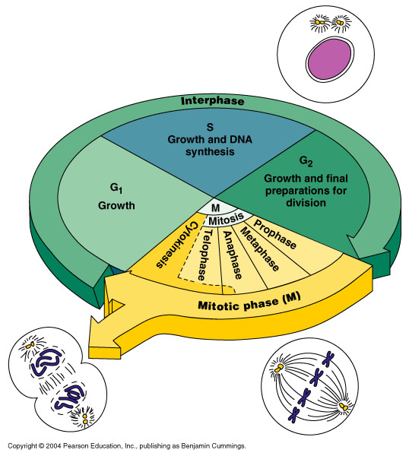
Notes:
Four Phases of the Cell Cycle: Growth (G1), DNA synthesis (S-phase), Premitotic (G2), and Mitotic (P, M, A, T)

Slide 10
CELL CYCLE
G0
  Quiescent (not a very long or dominent phase)
G1
  PRE-synthetic, but cell GROWTH taking place
S
  Cells which have continuous “turnover” have longer, or larger S-phases, i.e., DNA synthesis
  S-phase of TUMOR CELLS can be prognostic
G2
  PRE-mitotic, or, if you will, POST-synthetic
M (Mitotic:, P,M,A,T, Cytokinesis)

Slide 11
CELL TYPES
Labile: eg., marrow, GI
Quiescent: liver, kidney
NON-mitotic: neuron, striated muscle

Slide 12
STEM CELLS
(TOTIPOTENTIAL*)
EMBRYONIC
ADULT
Notes:
Differentiate TOTI- from OMNI- from PLEURI- potent cells. These terms are often used interchangeably, but perhaps not totally correctly

Slide 13
EMBRYONIC
STEM CELLS
DIFFERENTIATION
“KNOCKOUT” MICE (mice raised with specific gene defects)
REPOPULATION OF DAMAGED TISSUES, in research
Notes:
A knockout mouse is a genetically engineered mouse in which researchers have inactivated, or "knocked out," an existing gene by replacing it or disrupting it with an artificial piece of DNA. The loss of gene activity often causes changes in a mouse's phenotype, which includes appearance, behavior and other observable physical and biochemical characteristics.

Slide 14
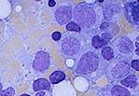

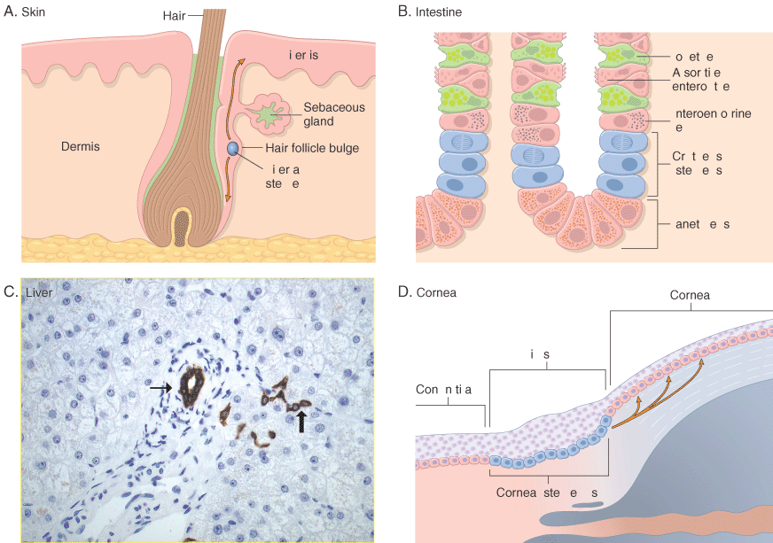
ADULT
STEM CELLS
MARROW (HEMOCYTOBLAST)
(hematopoetic stem cells)
NON-MARROW
(RESERVE)
Notes:
Adult stem cells, or “near” stem cells, are often given the term “toti-potential” or “pleuri-potential”, and are ubiquitous, even in blood.

Slide 15
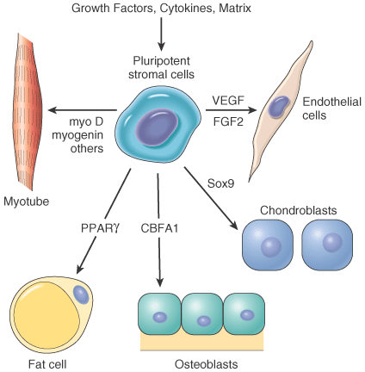
MARROW STROMAL CELL
Notes:
Diagram for the ever mysterious concept of “cell differentiation”, elucidated by “growth factors”. MSCs can be thought of as being the mother of all mesodermal cells. They look totally boring because of no cytoplasmic differentiation, i.e., mesenchyme.

Slide 16
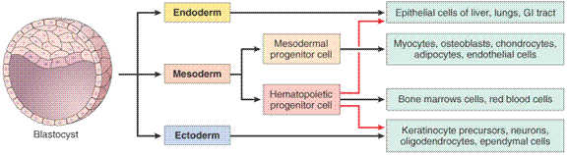
ADULT TISSUE DIFFERENTIATION and REGENERATION PARALLELS EMBRYONIC DEVELOPMENT
Notes:
Epithelium is generally thought of as arising from ectoderm or entoderm, while connective tissue, i.e., “stroma”, is thought of as arising from mesoderm.

Slide 17
Growth Factors (GFs)
Polypeptides
Cytokines
LOCOMOTION
CONTRACTILITY
DIFFERENTIATION
ANGIOGENESIS
Notes:
Please remember that these are the “general” features of GF’s

Slide 18
Growth Factors (GFs)
Epidermal
Transforming (alpha, beta)
Hepatocyte
Vascular Endothelial
Platelet Derived
Fibroblast
Keratinocyte
Cytokines (TNF, IL-1, Interferons)
Notes:
EGF, TGF, HGF, VEGF, PDGF, FGF, FGF, KGF, Cytokines. The NAMES can be misleading!

Slide 19
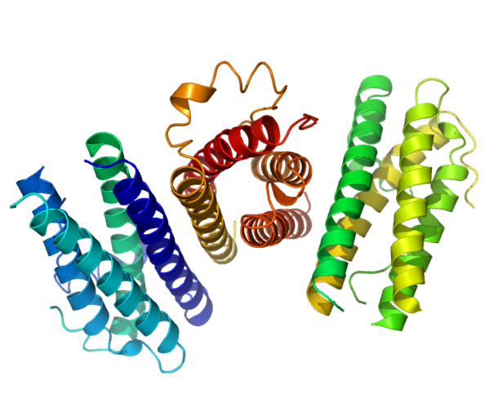
Notes:
Typical protein (polypeptide) configurations of GF’s

Slide 20
CELL PLAYERS
(source AND targets)
Lymphocytes, especially T-cells
Macrophages
Platelets
Endothelial cells
Fibroblasts
Keratinocytes
“Mesenchymal” cells
Smooth muscle cells
Notes:
The fact that the GF’s are made by the cells involved in inflammation and healing shows the PARACRINE nature of their behavior.
For EACH growth factor, you should have an idea WHERE it’s made, WHAT it does, and WHERE it goes. Often, the name helps you. Some can be made by “genetic engineering”!

Slide 21
E (Epidermal) GF
Made in platelets, macrophages
Present in saliva, milk, urine, plasma
Acts on keratinocytes to migrate, divide
Acts on fibroblasts to produce “granulation” tissue
Notes:
You can this that this GF works on both ectodermally as well as mesodermally (mesenchymal) derived cells.

Slide 22
T (Transforming) GF-alpha
Made in macrophages, T-cells, keratinocytes
Similar to EGF, also effect on hepatocytes

Slide 23
H (Hepatocyte) GF
Made in “mesenchymal” cells
Proliferation of epithelium, endothelium, hepatocytes
Effect on cell “motility”
Notes:
What is the concept of “induction” from embryology?

Slide 24
VE (Vascular Endothelial) GF
Made in mesenchymal cells
Triggered by HYPOXIA
Increases vascular permeability
Mitogenic for endothelial cells
KEY substance in promoting “granulation” tissue
Notes:
VEGF is probably the most widely studied of all GFs in relationship to diseases.

Slide 25
PD (Platelet Derived) GF
Made in platelets, but also MANY other cell types
Chemotactic for MANY cells
Mitogen for fibroblasts
Angiogenesis
Another KEY player in granulation tissue

Slide 26
F (Fibroblast) GF
Made in MANY cells
Chemotactic and mitogenic, for fibroblasts and keratinocytes
Re-epithelialization
Angiogenesis, wound contraction
Hematopoesis
Cardiac/Skeletal (striated) muscle

Slide 27
T (Transforming) GF-beta
Made in MANY CELLS
Chemotactic for PMNs and MANY other types of cells
Inhibits epithelial cells
Fibrogenic
Anti-Inflammatory
Notes:
This particular GF looks like it has many inhibitory functions, rather than stimulatory ones, i.e., control!

Slide 28
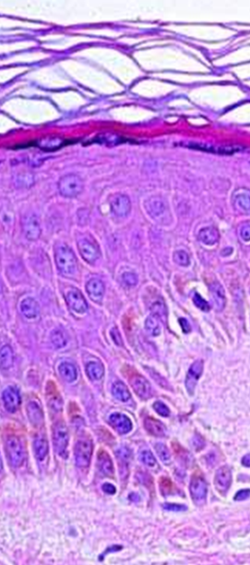
K (Keratinocyte) GF
Made in fibroblasts
Stimulates keratinocytes:
  Migration (motility)
  Proliferation (mitogen)
  Differentiation
Notes:
KEY interplay between mesoderm and ectoderm, like embryonic “induction”

Slide 29
I (Insulin-like) GF-1
Made in macrophages, fibroblasts
Stimulates:
  Sulfated proteoglycans
  Collagen
  Keratinocyte migration
  Fibroblast proliferation
Action similar to GH (Pituitary Growth Hormone)

Slide 30
TNF (Tumor Necrosis Factor) α and β
Made in macrophages, mast cells, T-cells
Activates macrophages
KEY influence on other cytokines
Notes:
What is cachexin?

Slide 31
Interleukins
Made in macrophages, mast cells, T-cells, but also MANY other cells
MANY functions:
  Chemotaxis
  Angiogenesis
  REGULATION of other cytokines

Slide 32
INTERFERONS
Made by lymphocytes, fibroblasts
Activates MACROPHAGES
Inhibits FIBROBLASTS
REGULATES other cytokines

Slide 33
SIGNALING
Autocrine (same cell)
Paracrine (next door neighbor) (many GFs)
Endocrine (far away, delivered by blood, steroid hormones)

Slide 34
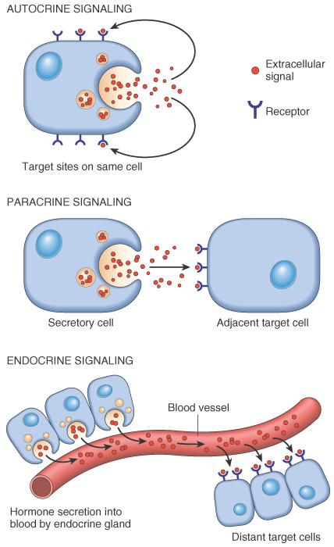
Notes:
Autocrine, paracrine, endocrine concepts

Slide 35
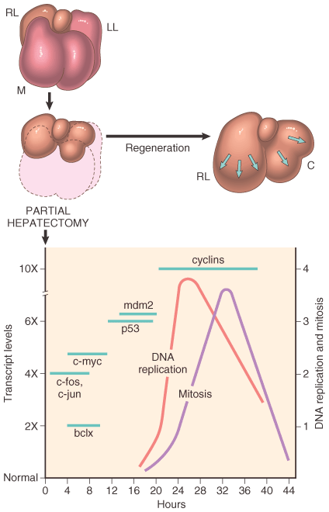
TRANSCRIPTION FACTORS
HEPATIC
REGENERATION
TNF
IL6
HGF
Notes:
Transcription factors take orders from GFs, in humans. In molecular biology and genetics, a transcription factor (sometimes called a sequence-specific DNA-binding factor) is a protein that binds to specific DNA sequences, thereby controlling the movement (or transcription) of genetic information from DNA to mRNA via RNA polymerase.

Slide 36
ExtraCellular Matrix (ECM)
Collagen(s) I-XVIII
Elastin
Fibrillin
CAMs (Cell Adhesion Molecules)
  Immunoglobulins, cadherins, integrins, selectins
Proteoglycans
Hyaluronic Acid
Notes:
The ever increasing cast of ECMs: CAMs=ImmunoGlobulin Super Family (IGSF), Cadherins, Selectins, Integrins
18 types of collagen of which Type-I is the most common

Slide 37
ECM
Maintain cell differentiation
“Scaffolding”
Establish microenvironment
Storage of GF’s

Slide 38
Collagen One - bONE (main component of bone)
Collagen Two - carTWOlage (main component of cartilage)
Collagen Three - reTHREEculate (main component of reticular fibers)
Collagen Four - FLOOR - forms the basement membrane

Slide 39
GENETIC COLLAGEN DISORDERS
I OSTEOGENESIS IMPERFECTA, E-D
II ACHONDROGENESIS TYPE II
III VASCULAR EHLERS-DANLOS
V CLASSICAL E-D
IX STICKLER SYNDROME
IV ALPORT SYNDROME
VI BETHLEM MYOPATHY
VII DYSTROPHIC EPIDERMOLYSIS BULLOS.
IX EPIPHYSEAL DYSPLASIAS
XVII GEN. EPIDERMOLYSYS BULLOSA
XV, XVIII KNOBLOCH SYNDROME
Notes:
Ehlers-Danlos: Hyperelastic skin
Achondrogenesis, Ib, 2: Small body, short limbs
Stickler syndrome: distinctive facial appearance, eye abnormalities, hearing loss, and joint problems, myopia, absent nasal bridge, hyperelasticity
Alport syndrome: glomerulonephritis, endstage kidney disease, and hearing loss
Bethlem myopathy: progressive myopathy, ankles fingers, joints
Dystrophic epidermolysis bullosa: a blistering disease
Knobloch syndrome: ophthalmic, retinal abnormalities
I would recommend that you become familiar with the general features of each “collagen disorder” and know how to relate it to the specifically numbered collagen defect.

Slide 40
DEFINITIONS:
REGENERATION: Growth of cells to replace lost tissues
HEALING: A reparative tissue response to a wound, inflammation or necrosis

Slide 41
HEALING
FOLLOWS INFLAMMATION→
PROLIFERATION and MIGRATION of connective tissue cells→
ANGIOGENESIS (Neovascularization)→
Collagen, other ECM protein synthesis→
Tissue Remodeling→
Wound contraction→
Increase in wound strength (scar = fibrosis)
LET’S MAKE THIS AS SIMPLE AS POSSIBLE:
1) NEUTROPHIL→ 2) ENDOTHELIAL CELL→ 3) FIBROBLAST
Notes:
Healing starts BEFORE the end of inflammation. If you remember the 3 possible final outcomes of acute inflammation, 1) complete regeneration, 2) chronic inflammation, and 3) fibrosis, “healing” is the usual process BEFORE you get to one of those 3 final outcomes. Note the yellow background on this slide. Not only is familiarity needed in all these steps but the PRECISE order is also need. You might call this Hollywood Epic, Part II.
The healing saga or epic, is now seen as the continuation of the inflammation saga or epic! The ORDER is LOGICAL! MOST IMPORTANT SEQUENCE TODAY!

Slide 42
ANGIOGENESIS
(NEOVASCULARIZATION)
From endothelial precursor cells
From PRE-existing vessels
Stimulated/Regulated by GF’s, especially VEGF
Also regulated by ECM proteins
aka, “GRANULATION”, “GRANULATION TISSUE”, “ORGANIZATION”, NEOVASCULARIZATION, “ORGANIZING INFLAMMATION”
Notes:
More likely than not, any GF will probably have a positive direct or indirect effect on angiogenesis, also called neovascularization, also called “organization”, or “organizing” inflammation, or “granulation”, or “granulation tissue”.

Slide 43
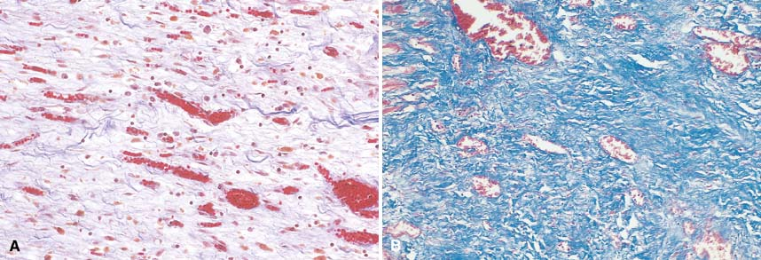
Notes:
Granulation on the left (many blood vessels), fibrosis on the right (trichrome stain stains collagen blue-green)
Inflamation→ Granulation→ Fibrosis Inflamation→ Granulation→ Fibrosis
Inflamation→ Granulation→ Fibrosis Inflamation→ Granulation→ Fibrosis
Inflamation→ Granulation→ Fibrosis Inflamation→ Granulation→ Fibrosis
Inflamation→ Granulation→ Fibrosis Inflamation→ Granulation→ Fibrosis

Slide 44
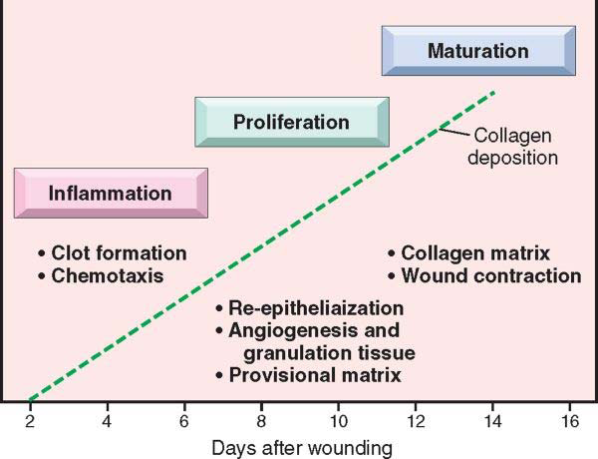
Notes:
It is tempting to estimate the actual times of events in tissue injury and repair. Another way to describe, in three words, the three phases of “repair”. In which phase would you see “fibrin”? Ans: Inflam. In which phase would you see a dense “scar”? Ans: Maturation Which phase is characterized by prominence of “budding” blood vessels? Ans: Prolif.

Slide 45
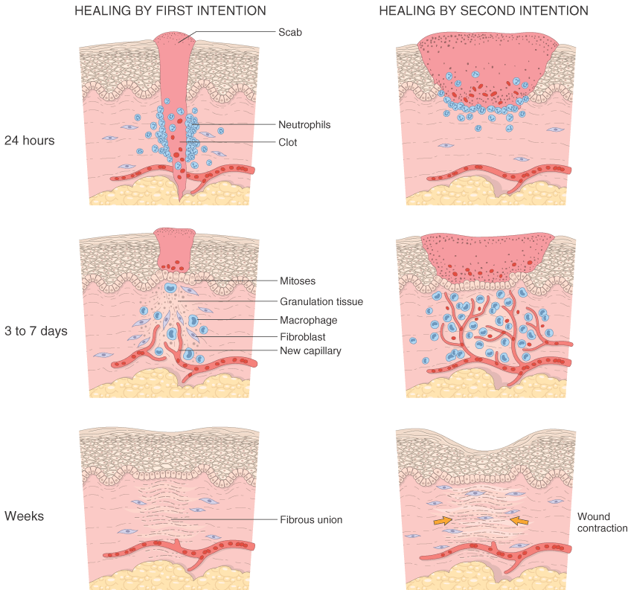
Notes:
Healing by SECOND intention involves a much greater destruction of the ECM, so therefore it is more likely to produce a greater amount of FIBROSIS. The degree of FIBROSIS is directly proportional to the amount of DESTRUCTION or DISRUPTUION of the ECM.

Slide 46
WOUND HEALING
1st INTENTION
Edges lined up
2nd INTENTION
Edges NOT lined up
Ergo….
More granulation
More epithelialization
MORE FIBROSIS
Notes:
The main difference between 1st and 2nd intention is: Are the edges of the wound lined up (1st), or not (2nd).

Slide 47
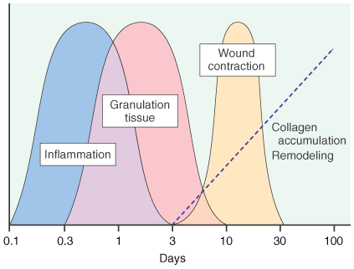
Notes:
These processes also parallel the appearance and regression of cells, namely, in order, neutrophils, macrophages, endothelial cells, fibroblasts. This is my favorite graph, because it summarizes the whole chapter!

Slide 48
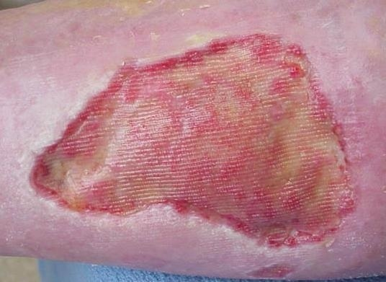
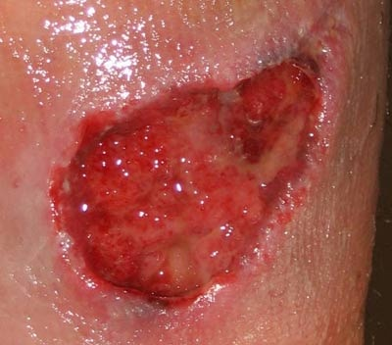
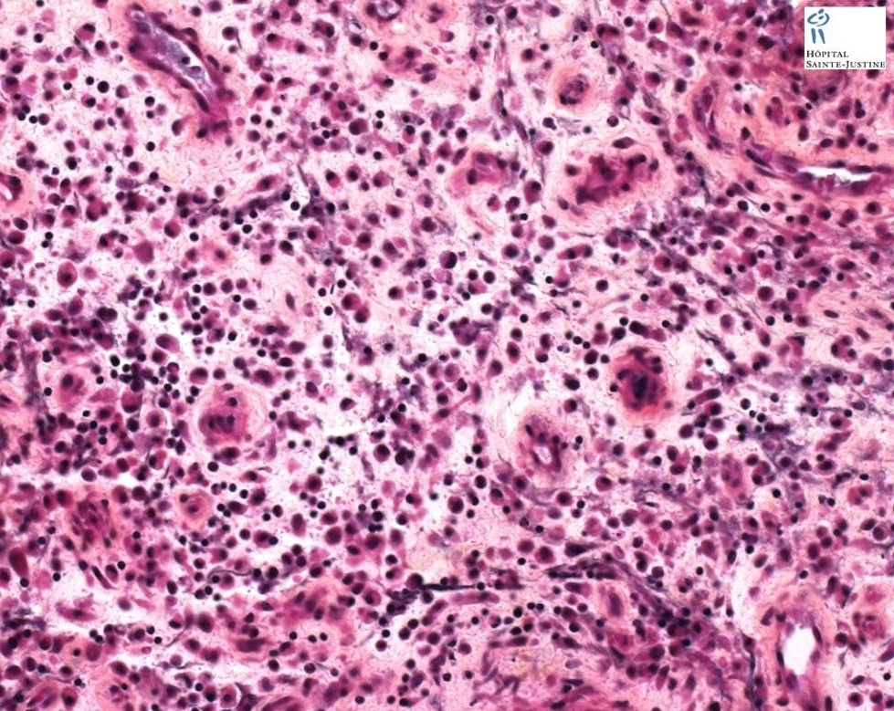
“HEALTHY” Granulation Tissue
Notes:
OFTEN, totally HEALTHY granulation tissue can be described as “INFECTED”. Don’t get caught making this mistake. Why are there “lines” on the upper left image?

Slide 49
FIBROSIS/SCARRING
DEPOSITION OF COLLAGEN by FIBROBLASTS
With time (weeks, months, years?) the collagen becomes more dense, ergo, the tissue becomes “STRONGER”

Slide 50
Wound RETARDING factors
(LOCAL)
DECREASED Blood supply
Denervation
Local Infection
FB
Hematoma
Mechanical stress
Necrotic tissue

Slide 51
Wound RETARDING factors
(SYSTEMIC)
DECREASED Blood supply
Age
Anemia
Malignancy
Malnutrition
Obesity
Infection
Organ failure

